Slide 1

Analyzing Advances in Anomaly and Outliers Detection Based Algorithms
CAP 6778 - M. Khoshgoftaar - Nov, 25, 2021
Shaun Pritchard * Florida Atlantic University ∗ Email:spritchard2021@fau.edu

Slide 2
Analyzing Anomaly Detection Algorithms Based on Outliers and State-Of-The-Art Advances
Introduction of works
Notes:
This research compares 40 novel, baseline, and state-of-the-art unsupervised machine learning algorithms and techniques. Which examines a number of factors that contribute to the emergence of outliers and advances in state-of-the-art anomaly detection.
Through the detection of these anomalies, models can be improved as well as critical issues detected. This research will assess the baseline research and more modern advanced benchmarked techniques in unsupervised machine learning algorithms to evaluate problems with current outlier detection systems and algorithms in contrast.
The evaluation will take an in-depth look at promising Outlier, Anomaly Detection Techniques, and algorithms for mixed type, general, and High-Dimensional Data
Also evaluates well-defined analysis distribution from the perspective of several research fields and applications of
Intrusion Detection,
Fraud Detection,
Medical Health,
Industrial Damage Detection,
Sensor Networks,
Textual Anomaly Detection,
Autonomous vehicles
Image Processing.
And so on…
- The datasets used for benchmark comparisons include both synthetic and novel datasets with a mix of both nominal and categorical features. The results of this study include the creation of a complete and comprehensive resource of outlier and anomalies detection algorithms, including their extensive features of state-of-the-art detection methods.

Slide 3
01
02
03
04
05
06
Index
Introduction
Issues
Techniques
Critiques
Summary
Conclusion
Notes:
Introduction into the works of this research, Analysis of the outlier problem while also discussing assumption of novel, outlier and anomaly detection
Discuss common issues in the field of unsupervised outlier detection
Current baseline techniques and models implemented compared to newer more robust models
Critique of baseline models and current techniques
Summary of works
Conclusions and future works in the related field

Slide 4
01
Section

Slide 5
Outline
Intro
Outline
Defining anomaly detection
Setting of outlier detection
Datasets for unsupervised detection
Assumptions about anomaly detection
Defining detection methods
Notes:
The goal of the initial research is to provide a comprehensive overview of the various implementations of outlier and anomaly detection techniques using baseline study and other comparative research to define assumptions about data and efficient algorithms of outlier and anomaly detection, as well as an overview of the contrasts between the various approaches and their respective use-cases.
So the outline goes through several different topics I want to start by defining the problem of anomaly detection or novelty detection
Because compared to supervised learning, unsupervised learning has been less studied and is certainly more interest in it that has really picked up in the last few years because the interest of robust AI.
My research has showed a rich database of Publications in this area.
Read List of outline topics

Slide 6



Defining Anomaly Detection
Data
What a Mixture of “nominal” points and “anomaly” points
Anomaly points are generative by a different process than the nominal points
Anomaly detector: = the anomaly score
Goals
Find all the anomalies in the training data
Determine whether a new query point ia an anomaly
[Dietterich el al.,2021]
Notes:
So what do we mean by anomaly detection we assume we're going to be working with data that are in the form of feature vectors in dimensional real space
That our data consists of mixture of what of what is called nominal points, which are “non-anomalies and the normal points” with the anomaly points
An anomaly is not just a statistical outlier in all cases, in fact it may not be a statistical outlier if the key thing is that these anomaly points are being generated by some process that's different than the process that's generating the nominal points
The anomalies in financial transactions may be the result of fraudulent trend for instance being adversarial
Such as criminals engaging in fraud as opposed to some normal assumed distribution of diagnosed machine failures.
By denoting a of X, we denote the anomaly score computed by some anomaly detection algorithm, which could be broken machines or broken sensors in some network. With the idea that larger scores generally mean things are more anomalous and we may have a variety of globals.
For example, it might be something like data cleaning, but given a set of data points, we might want to find all anomalies in that training data.
In a sense, we want to find fraudulent or transactions in our transaction data. We might also want to know whether a new query point that wasn't in our training data is a nominal point or an anomaly point, so it's a kind of classification type problem, except that we don't have any training data for the anomalies.
According to [Dietterich el al.,2021]

Slide 7
Setting of outlier detection
Supervised Training
Data labeled with “nominal” or “anomaly”
Clean
Training data are all “nominal”, test data may be contaminated with “anomaly” points.
Unsupervised Training
data consist of mixture of “nominal” and “anomaly” points
[Dietterich el al.,2021]
Notes:
There are three settings
The first one is supervised denominator detection where we do have training data
The second one is where the training data are clean so they have they're not contaminated with any anomalies but our test data is going to contain anomalies and so we want to detect those and the
Third is of the unsupervised case where both our training and our test data have anomalies in them and we want to deal with that fact in one way or another.
The supervised case is the least interesting because in most applications of anomaly detection the anomalies are very rare and so even if you have labelled anomaly data it represents such a tiny fraction of your training data that supervised learning really can't work with it the class imbalance is too severe for instance.
For example we might have anomaly rates of you know 1 in 10,000 and 100,000 and so that's a very hard case for supervised learning.
In most applications there are no training data available for the unsupervised setting
I will focus on this research

Slide 8
Datasets for Unsupervised Detection
Datasets drawn from specific application problems
Synthetic datasets
Constructed from supervised classification problems
[Dietterich el al.,2021]
Notes:
In anomaly detection research, three kinds of data have been employed to analyze and evaluate anomaly detection algorithms.
First, there are datasets drawn from specific application problems (e.g., [Xue et al. 2006; Lazarevic et al. 2003]).
Second, there are synthetic datasets [Rocke and Woodruff 1996].
Third, there are datasets constructed by taking an existing supervised classification problem and treating one or more of the classes as the anomalies.
Application-specific datasets are very useful. They can help understand and evaluate the algorithm refinements needed to achieve high performance in a particular application. However, often the datasets are not publicly available because of privacy or security considerations (e.g., [Senator et al. 2013]).

Slide 9
Assumptions About Anomaly Distributions
Do probability distributions explain anomalies?
Ex: repeat instances of known machine failures
Risk associated with assumptions:
Adversarial situations (i.e. Fraud, attacks, threats)
Diverse set of potential causes (Novel failure modes)
Users' notions of anomalies change over time (e.g., anomaly = interesting point).
[Dietterich el al.,2021]
Notes:
Another important question about any application of anomaly detection is whether we can assume that the anomalies are coming from a well-defined probability distribution
Say that the anomalies are the result of repeated instances of known machine failures. In which case we might be willing to assume that the machines are not adversarial and so this is some well-defined distribution that is just so sparse that we can't model it and therefore need to treat it as some anomaly.
In most instances, making this assumption is very risky, especially in adversarial cases. For instance, in fraud insider threats or cybersecurity, your adversaries will adapt to whatever the learning algorithm discovers, so the distribution will shift.
Another factor is that in open world machine learning, where arbitrary inputs (data with undetected classes) are combined with closed-world models trained on in-distribution data and out-of-distribution data (OOD), there are a number of potential causes of anomalies or processes.
It is very risky to assume that we have a good sample of those and so maybe we can't safely make this assumption.
An anomaly can also be seen as a point of interest that isn't a normal observation, after which the observation becomes no longer interesting and something new is expected, and so the understanding of what is interesting has been evolving over time.

Slide 10
Defining Assumptions
Univariate
Basic model is univariate, i.e., 1-dimensional
Basic model Assumes only one normal generation mechanism.
Basic model assumes that outliers are rare observations
Multivariate
Data are usually multivariate, i.e., multi-dimensional
There is usually more than one generating mechanism/statistical process underlying the “normal” data.
Anomalies may represent a different class (generating mechanism) of objects, so there may be large class of similar objects that are outliers.
Notes:
Univariate
Basic model is univariate, i.e., 1-dimensional
Basic model Assumes only one normal generation mechanism.
Basic model assumes that outliers are rare observations
Multivariate
Data are usually multivariate, i.e., multi-dimensional
There is usually more than one generating mechanism/statistical process underlying the “normal” data.
Anomalies may represent a different class (generating mechanism) of objects, so there may be large class of similar objects that are outliers.

Slide 11
Strategies for Unsupervised Anomaly Detection
Where, 𝛼 is a fraction of the training point that are anomalies:
Case 1: 𝛼 is large (e.g., > 5%)
Fit a 2-component mixture model
Requires assumptions of the normal distribution
Mixture components must be identifiable
Mixture components cannot have large overlap in high density regions
Case 2: 𝛼𝛼 is small (e.g., 1%, 0.1%, 0.01%, 0.001%)
Anomaly detection via Outlier detection
Does not require WDAD assumption
Will fail if anomalies are not outliers (e.g., overlap with nominal density; tightly clustered anomaly density)
Will fail if nominal distribution has heavy tails
[Dietterich el al.,2021]
Notes:
The two main strategies are based on the frequency and fraction of the anomalies.
If we denote by alpha the fraction of training points that are anomalies, then the first case occurs when alpha is at least five percent of the data. Using an unsupervised learning approach, we can fit a two-component mixture model. One component will cover the nominals and the other will cover the anomalies. Even if we have an idea of the size of alpha, we can say a priori we want one mixture component that covers five percent of the data and another one that covers 95 percent. Since we are modeling the anomalies as having a distribution, we must make the assumption that the components are recognizable
Second, if alpha is very small, it can be very small, and in this case, we typically approach anomaly detection by treating it like outlier detection. In other words, we hope the anomalies are very distinct from the nominal data. Alternatively, we can avoid making the distribution assumption, but this will fail if the anomalies are not outliers. Especially in adversarial cases where your adversaries are trying to look like they're normal. The latter can be quite difficult to detect and are sometimes called tells, so you have to be familiar with them. A characteristic of the fraudster's behavior that is essential to carrying out the fraud indicates its outlier nature. This will also fail of course if the nominal distribution itself is highly skewed so that it naturally produces a lot of outliers.

Slide 12
Defining Detection Methods
Novelty detection
Outlier (e.g., anomalies) detection
Notes:
Novelty detection aims is to detect any new observations that can be fit into a data set containing only good data
The training data is not polluted by outliers and we are interested in detecting whether a new observation is an outlier. In this context an outlier is also called a novelty.
Detecting outliers or . anomalies, is concerned with identifying outliers in data where The training data contains outliers which are defined as observations that are far from the others. Outlier detection estimators thus try to fit the regions where the training data is the most concentrated, ignoring the deviant observations..

Slide 13
02
Section
Notes:
This section we discuss the underlying issues discovered in the research from the baseline and other prominent research areas in outlier detection.

Slide 14
Outline
Issues
Consequences
Benchmarking issues
Concerns in outlier detection
Outlier detection issues

Slide 15
Consequences
There have been a lot of models and approaches developed over the past few years to overcome these assumptions.
This evolution can be difficult to follow.
The assumptions and restrictions in new models are usually hidden, but sometimes they are typical, sometimes new

Slide 16
Benchmarking Issue
Most AD papers only evaluate on a few datasets
Often proprietary or very easy (e.g., KDD 1999)
Research community needs a large and growing collection of public anomaly benchmarks
[Dietterich el al.,2021]
Notes:
Research shows that Most AD papers only evaluate on a few datasets typically propitiatory data in corporate setting not readily available for researchers to use
Research community needs a large and growing collection of public anomaly benchmarks in an array of fields

Slide 17
Concerns in outlier detection
How to identify and model normal objects for detection?
How do we define outliers?
How do we handle noise in data?
How do we define applications specific datasets?
How can we justify outlier detection methods?
Notes:
As data dimensions increase, any distance between any data objects becomes meaningless. Therefore, the first concern would be identifying outliers and how to model normal objects. A method for detecting outliers is highly dependent on its ability to model normal objects and outliers.
Another question is how to define an outlier since applications of outlier analysis are diverse and apply to a variety of areas, including fault detection, intrusion detection, financial fraud, web log analytics, sensor systems, medical applications and so on.
There is also the issue of handling noise in outlier detection. Data sets collected in a wide range of application domains tend to have poor quality because noise tends to be invariable.
Outlier detection depends on the choice of the appropriate similarity or distance measure as well as the relationship model for describing data objects, and these choices are usually determined by the application, since every application has its own set of requirements. How do we benchmark Application-specific datasets efficiently?
Additionally, there is the issue of comprehension. Typically, a user may not only wish to perform outlier detection, but also wish to understand why the detected objects are outliers. In order to satisfy this requirement, it is desirable that an outlier detection method can justify the detection in some way.

Slide 18
Outlier Detection Issues
Anomalies may degrade the final model if the training algorithm lacks robustness.
If anomalies overlap in nominal clusters, it can be hard to detect them, and these clusters must be dense enough for a reliable model to be developed.
Using a dataset contaminated by outliers is a major concern, as it results in inaccurate results.
When outliers are not detected correctly, system reliability can suffer in safety critical environments, where the presence of outliers may imply abnormal activity, such as fraud.
Distorted data can blur the distinction between normal objects and outliers.
Noise and missing data may hide outliers and reduce the effectiveness of outlier detection.
For production, testing novel data is insufficient for real-world training models in most cases.
Based on benchmarks and complexity, which algorithms implement the best performance depends on the data type.(which performance metrics are best for which application)
Another main issue is that in real world cases the underlying distribution is usually unknown and cannot be estimated from data without outliers affecting the estimate, thus creating the chicken and the egg problem.
Notes:
Furthermore, What are the best methods for data-mining outliers?
Outliers are data points that differ greatly from the majority. A model of the normal patterns is often required to produce an outlier score. Outliers are points of data that don't follow this normal model. Outlier detection poses a number of challenges as follows.
Using a dataset contaminated by outliers is a major concern, as it results in inaccurate results in novel cases.
Anomalies may degrade the final model if the training algorithm lacks robustness.
If anomalies overlap in nominal clusters, it can be hard to detect them, and these clusters must be dense enough for a reliable model to be developed.
When outliers are not detected correctly, system reliability can suffer in safety critical environments, where the presence of outliers may imply abnormal activity, such as fraud.
Distorted data can blur the distinction between normal objects and outliers.
Noise and missing data may hide outliers and reduce the effectiveness of outlier detection.
For production, testing novel data is insufficient for real-world training models in most cases.
Based on benchmarks and complexity, which algorithms implement the best performance depends on the data type.
Another main issue is that in real world cases the underlying distribution is usually unknown and cannot be estimated from data without outliers affecting the estimate, thus creating the chicken and the egg problem of which came first.
These issue pose many open ended questions in the field of study

Slide 19
03
Section
Notes:
This study evaluates a number of novel, baseline, and state-of-the-art detection techniques as well as defines key issues with the outlier detection problem.
Based on the underlying approach adopted by each technique l, I have divided existing techniques into different categories based on types, techniques , methods, and models.
The techniques use key assumptions to distinguish between normal and atypical behavior within each category.
Following this, we will discuss the literature review study conducted in which the baseline research is compared to multiple other sources so as to extend the baseline research.
My initial research compares 40 outlier detection techniques and models in terms of applications that extend the baseline

Slide 20
Outline
Techniques
Classification approach
Variability of data
Processing data for outliers ness
Outlier methods
Outlier models
Comparative analysis
Propoabalisty based detection
Neighborhood based detection
Subspace detection
Ensemble based detection
Mixed model type detection

Slide 21
Classification Approaches
Global versus local outlier detection
Labeling versus scoring outliers
Modeling properties
Notes:
– Global versus local outlier detection Considers the set of reference objects relative to which each point’s “outlierness” is judged is judged
– Labeling g versus scoring outliers Considers the output of an algorithm
– Modeling properties Considers the concepts based on which “outlierness” is modeled

Slide 22
Variability of Data
General data:
High-dimensional data:
High-density data:
Mixed type data:
Real-Time data:
Notes:
Several types of data need to be considered in unsupervised outlier detection problems,
One of the most important factors in detecting outliers and anomalies is the data set explaining variability.
(review)
General data: There are two types of general data, univariate and multivariate, which contain nominal or categorical data, which contribute to data problems of lower feature dimensionality and are assumed to be normally distributed.
High-dimensional data: Datasets with a greater number of feature characteristics p than observations N. high-dimensional data implies many dimensions/variables/features/columns.
High-density data: Often refers to massive amounts of data from multiple sources, multiple data sets, or crowded datasets with multiple data points per feature making the data dense.
Mixed type data: refers to data that are a combination of realizations from both continuous and categorical from random variables and is typically handled with clustering methods.
Real-Time data: refers to asynchronous information that is delivered immediately after collection and persistance. There is no delay in the timeliness of the information provided. Real-time data is often used for navigation or tracking

Slide 23
Processing data for outlierness
Normal data
Time-Series data
Evolving data
Graph & Network data
Notes:
We can further categorize the type of data for the outlier detection problem as follows
Normal data: These are instances data types are dependent on the normal distribution.
Time series data: A time series can be classified into two types of outliers: point outliers (which are deviations from assumptions at a given time) and shape outliers (which are data points in a contiguous window that are anomalous rather than a single point). Outliers can be found within the time series as particular elements (or time points) or subsequences, known as point outliers and shape outliers, respectively. Time series data can also be dynamic or real time data.
Evolving Data: In a real-time or adaptive data stream, data points may change, with feature values changing, and feature space may change, with newly-emerging features over time. Row-streams, on the other hand, deliver points with fixed features one by one.
Graph & Network data: techniques for structured graph data have been of focus recently. As objects in graphs have long-range correlations, a suite of novel technology has been developed for anomaly detection in graph data.

Slide 24
Outlier Methods
Probability-based methods
Clustering-based methods
Distance-based methods
Density-based methods
Projection-based Methods
Ranking-based methods
Notes:
Further categorization is based of different methods which outlier detection analysis is applied
Probability-based methods: Statistical models rely on the assumption that the majority of the data follows a statistical distribution, and the degree to which an item is an outlier is determined by evaluating the likelihood that the item is generated by the same distribution. In general, the smaller the likelihood, the more unlikely the object is to be from the same distribution, and the more likely it is to be an outlier. Univariate tails are defined as extreme regions that have a probability density below a certain threshold after a model distribution has been chosen.
Clustering-based methods: A clustering algorithm looks for data points that occur together in a group. Models based on clustering look for data points that are isolated from clusters and determine outliers as a result of clustering. Outliers occur in small clusters of their own. Let X1, …, Xn be a set of clusters of a dataset Let X1, ..., Xm be a set of clusters of a dataset T generated by a clustering algorithm, listed in the order of |X1| ≥ |X2| ≥···≥ |Xn |. Given parameters, α, and β, clustering-based outliers are those clusters in Xm through Xn such that the sum of |X1|+|X2|+···+|Xm−1| |T |∗α, |X1|+|X2|+···+|Xm−2| ≤ |T |∗α, and|Xm−1|/|Xm| > β. As a result, every data point belongs to a cluster, or else it is considered an outlier. Clustering-based approaches detect outliers by examining the relationship between objects and clusters.
Distance-based methods: To determine whether a data point is an outlier, distance-based models use its Euclidean distance k-nearest neighbors. Outliers are data points whose average distance to their k-closest neighbors is much greater than the distance to their k-th nearest neighbors. Where an object O is in a dataset T is a distance-based outlier, denoted by DB(p, D)-an outlier. Most nearest neighbor techniques calculate the distance or similarity measure between an observation and its neighbors.
Density-based methods: The outlier score of a density-based model is determined by the local density of the data point. Outlier scores based on density are usually computed by comparing the local density of an object to the average of its k-nearest neighbors' local density. When cluster density and shape significantly vary with data location, this model is most commonly used.
Projection-based Methods: A distance-based threshold for outlier detection can be established using data-driven estimation of the degrees of freedom and scaling parameters of partial distances in the projection models. A sequential outlier detection procedure is based on a joint threshold. In projection models, outliers are identified as occurrences that are less frequent and in terms of their values differ from regular observations.
Ranking-based methods: A ranked-based method examines whether a target is 'central' among its nearest neighbors based on the density of its nearest neighbors. This eliminates the problem of the calculation of density in the neighborhood of the ranking values to data points or evaluations located in a cluster where the cumulative sum of the ranks is relatively low.

Slide 25
Outlier Models
Probabilistic Model
Neighborhood Model
Sub-Space Model
Ensemble Model
Mixed Models
Notes:
For the research study I implemented I further categorized the baseline detection methods into specific models as follows.
These are the models in which the base categories observe the comparative analysis of the 40 different algorithms.
Probabilistic-based detection: Detects anomalies in statistical distributions using statistical measures. Outlier anomaly detection can rely on rudimentary based algorithm techniques like z-score, modified z-score, IQR, boxplot, and histogram as basic filters. In learning problems, the data tend to follow a statistical distribution, and there can be different levels of complexity for unsupervised learning problems.
Neighbor-based detection: Identifying anomalies by using neighbourhood information. Typical examples include kNN[], kNNW[10], LOF[], LoOP[], ODIN[], RBDA[], etc.
Subspace-based detection: Anomalies can be detected through inference of different feature subsets. These include SOD[7], [14, 15], RODS[16], OR[17], [18], etc.
Ensemble-based detection: Using Ensemble techniques, Integrating multiple anomaly detection events to achieve a consensus. Such algorithms are FB [19], HiCS [8], Stein et al. [20], Zimek et al. [21], Passillas et al. [22], and so on.
Mixed-based detection: Making a unified model for different data types, or taking each data type separately. Classical examples have LOADED [23], ODMAD [24], Zhang et al. [25], Lu et al. [26], Do et al. [27], and so on. Deep Learning Based detection methods are most state of the art and advanced apropo.

Slide 26
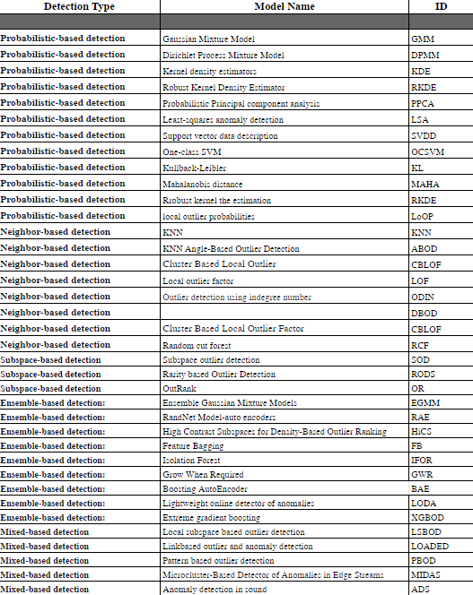
Comparative Analysis
5 model categories outlier detection
Analysis of plausible issues and comparison with baseline study.

Slide 27
Probability Based Detection
Normal behavior
Mean and standard deviation are very sensitive to outliers
These values are computed for the complete data set (including potential These values are computed for the complete data set (including potential outliers)
Low flexibility (no mixture model) Utilizes full feature space
Computationally expensive in high dimensions
Issues with noise
Notes:
Most algorithms tend to break down in high-dimensional feature spaces because classes of objects often exist in specific subspace of the original feature space
• Inaccurate boundaries between the outlier and normal behavior
• The high possibility of the normal behavior to continue to evolve and perhaps it might not be a correct representation in the future
• Different applications and conflicting notion make it hard to apply techniques developed in one field to another
• Noise in the data which mimics real outliers and therefore makes is challenging to distinguish and remove them

Slide 28
Neighborhood-Based Detection
Are outliers just a side product of some clustering algorithms?
Clustering algorithms are optimized to find clusters rather than outliers.
Accuracy of outlier detection depends on how good the clustering algorithm captures the structure of clusters.
A set of many abnormal data objects that are similar to each other would be recognized as a cluster rather than as noise/outliers.
Notes:
Assuming that neighborhood based algorithms are clustering algorithms, we can also categorize decision and random trees in this category, but in retrospect, this would be considered bivariate.
Nonetheless:
Many clustering algorithms do not assign all points to clusters but account for noise objects account for noise objects look for outliers by applying one of those algorithms and retrieve the noise set clustering algorithms are optimized to find clusters rather than outliers.
These are consideration we need to define about clustering algorithms.
Clustering algorithms are optimized to find clusters rather than outliers.
Accuracy of outlier detection depends on how good the clustering algorithm captures the structure of clusters.
A set of many abnormal data objects that are similar to each other would be recognized as a cluster rather than as noise/outliers.

Slide 29
Subspace Outlier Detection
Uses different subspaces for different objects.
local density based outlier detection can cope with high-dimensional data.
Approaches yields results of significantly better quality than existing algorithms.
Can be applied in higher dimension problems
Notes:
Detect outliers from the complete data space considering all the dimensions
But most outliers are often denoted as rare neighborhood activities in a declining dimensional subspace. For objects with several attributes,
Applied in high dimensional problems
Discover meaningful outliers in a well-organized way by examining dissimilar subsets of dimensions in the dataset.
Approaches are divided into sparse subspace and relevant subspace methods.
The former project the high-dimensional data points onto sparse and low dimensional subspaces. These objects within the sparse subspace can then be labeled as outliers since they are characterized with a lower density. One big drawback of these methods is the time consumption with regards to exploring the sparse projections from the entire high-dimensional space. To address this drawback, Aggarwal et al. [6] proposed a method that improves the effectiveness of exploring the subspaces. The subspaces are achieved through an evolutionary algorithm. However, the performance evaluation of the algorithm is highly dependent on the initial population

Slide 30
Ensemble Outlier Considerations
Better performance
Ensemble techniques are used in cases where one is prompted to answer the question of whether an outlier should be a linear-model based, distance based, or other kinds of model-based
Applied in classification and clustering problems.
Reduce the dependency of one model to a particular dataset or data locality.
Are more difficult and complex
Notes:
Although ensemble-based techniques for outlier detection when compared to other OD methods
They are often used in recent outlier detection problems [183], [184], and have more open challenges.
Ensemble techniques are used in cases where one is prompted to answer the question of whether an outlier should be a linear-model based, distance based, or other kinds of model-based.
They are usually applied in classification and clustering problems.
They combine the results from dissimilar models to produce more robust models and then reduce the dependency of one model to a particular dataset or data locality.
However, ensemble methods in the context of outlier detection are known to be very difficult. Compared to other techniques that have been introduced, including the following:
(I) Bagging [37] and boosting [184] for classification problems
(ii) Isolation forest [192] for parallel techniques.
(iii) for sequential methods [185] and Extreme Gradient Boosting Outlier Detection (XGBOD) [183] and a Bagged Outlier Representation Ensemble (BORE) [186] for the hybrid methods.

Slide 31
Mixed-type Outlier Detection
Uses different approaches and models for for mixed type data and approaches
Makes a unified model for different data types
Considered Data types separably
Notes:
Uses different approaches and models for for mixed type data and approaches
Makes a unified model for different data types
Considered Data types separably

Slide 32
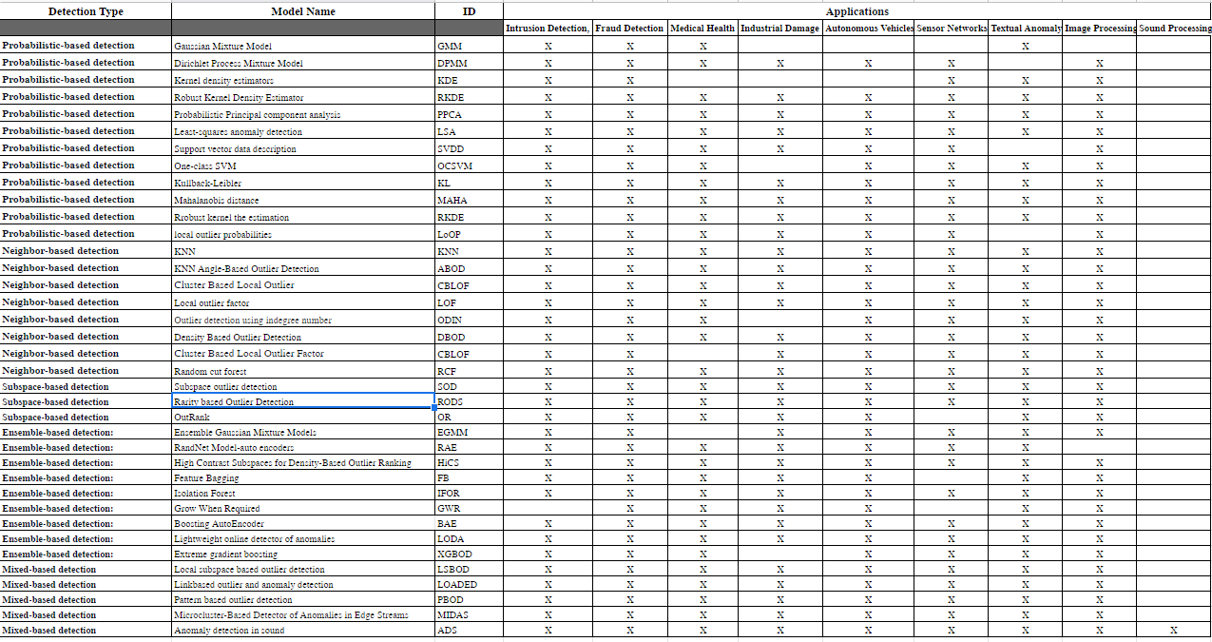
Comparative application analysis 40 outlier detection algorithms
Notes:
These are the results of my comparative analysis including the Baseline research documents which includes the probabilistic models the neighborhood base models and symbol Subspace mixtape models and the various algorithms and the proposed applications in which they've been benchmarked and studied.
In my research paper i conducted a more indepth survey of the algorithms.

Slide 33
04
Section
Notes:
Consequently, many of the proposed algorithms have limitations, while others have proven versatile and robust, which have been overcome or replaced by modern advances in technology through advances in statistical techniques for artificial intelligence.
In many cases, this research shows astounding performance yet a lack of benchmarks, yet is still apropos for future work through the use of mixed models and ensemble methods. In the context of this study, it appears that outlier detection and corresponding techniques have vast potential for advancement in a number of different fields.

Slide 34
Outline
Challenges to current approaches
IFOREST
Advances in outlier detection
PAC learning theory concept
Top algorithms

Slide 35
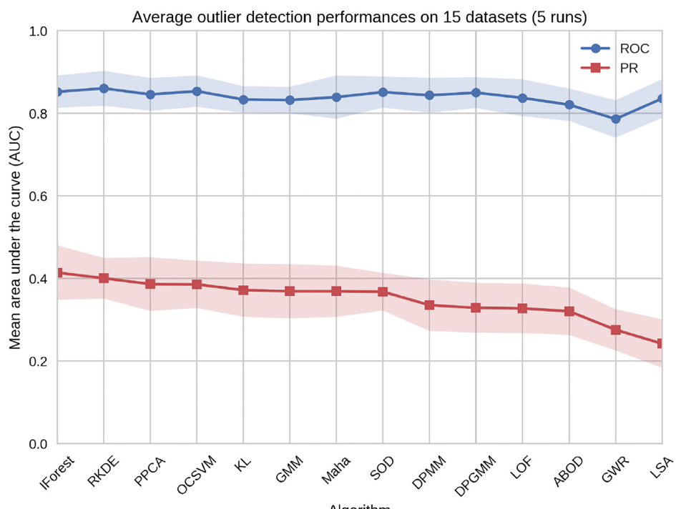
Challenges to current approaches
ROC and PR results for Baseline study
IFOREST showed top performance
Notes:
Mean area under the ROC and PR curve per algorithm (descending PR).
IFOREST has been shown in this study to be an excellent method for identifying outliers in large datasets while also showing excellent scalability on large datasets and a reasonable memory usage for datasets up to one million samples. According to the results, this algorithm is better suited to a production environment than RKDE
Other studies that I evaluated IFOREST also showed high performance in comparision

Slide 36
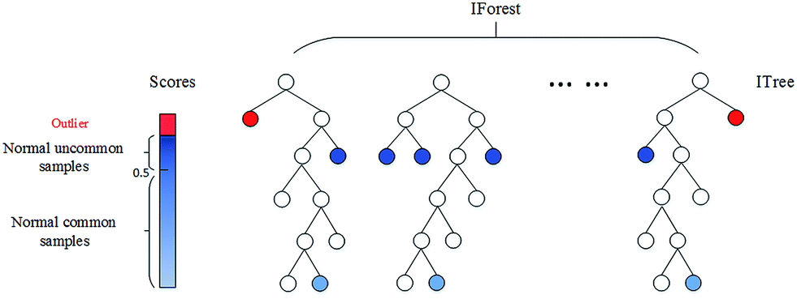
IFOREST
Notes:
Isolation Forest: In order to isolate outliers, the Isolation Forest algorithm [35] takes advantage of two main characteristics of outliers: First, they are by definition the minority within a dataset, accounted for by a small number of instances, and second, they have characteristics that deviate from the mainstream distribution. A feature is randomly selected from the feature space after recursively partitioning it, and a split value is selected between the maximum and minimum value for the selected feature. Due to the two aforementioned properties, such a partitioning most likely results in outlier observations at the root of the tree, having a shorter average path length, requiring fewer splits. A major advantage of isolation forests is that they allow for sampling. With newer baseline methods and mixed models, which I will discuss later, the IFOR algorithm has shown great performance in consumption.

Slide 37
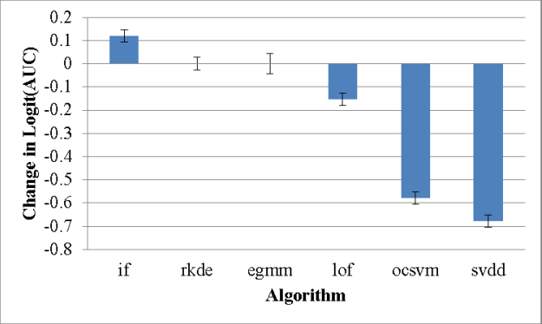
Advances in Outlier Detection
PAC Analyst Feedback
Sequential Feature Explanation (SFE)
Oregon State University (Dietterich el al.,2021)
Notes:
This study [Dietterich el al.,2021], showed that IFOREST very high performance using weather sensor array datasets, This algorithm outperformed state-of-the-art algorithms LODA,ABOD,LOF,SVDD,and OCSVM

Slide 38
PAC Learning Theory Concept
Data
Expert Labels the best candidate
Label is used to update anomaly detector
Anomaly Detection
Best Candidate
Convince Expert
no
yes
Launches Investigation
Notes:
When IFOREST was implemented ands compared to the later algorithms with new advanced concept PAC analyst feedback which is an advancement concept of getting analyst feedback on the anomalies where the most anomalous instances are presented to the analyst along with their explanations to obtain their labels.
PAC learning theory of anomaly detection was developed by Allen fern by incorporating feedback during the anomaly detection. The analyst investigates one or more items and labels each as either a true positive or false positive. This feedback is incorporated using a recent work [microsoft] that shows that feedback can improve the anomaly detection performance significantly as shown in Fig.2.
This is a concept that showed high performance using more state of the art technuiqes

Slide 39
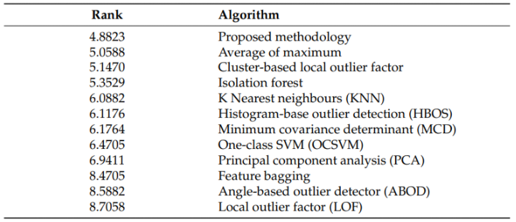
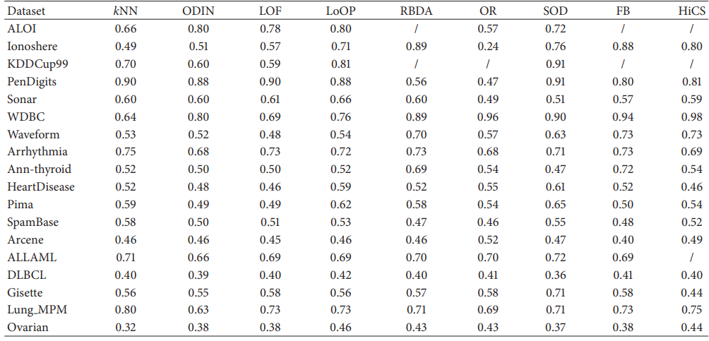
Top Algorithm Evaluations
IFOREST
RandNet Autoencoder
BEA
MIDAS
XGBOD
LOADED
LOF
HiSC
LSBOD
FB
Notes:
For brevity of this presentation giving my 25 to 30 min trance I redirect to my research analysis which covers more in depth evaluation of the algorithms. But from the algorithm said I researched these one stretchy interest with me. Noticeably they are ensemble and mixed based algorithms which showed promising performance and overall value for outlier detection.

Slide 40
What Matters Most
Algorithms are not most important
Considering datasets
Considering relative frequency of the data
Notes:
While the algorithms play a vital role in outlier and anomaly detection the data set explains variability for the relative frequency that's most important and the data set and relative frequency.

Slide 41
Critiques
The baseline benchmark performance on synthetic data was isolated
Rare use of feature selection
Not enough inference of mixed data
Utilizing more efficient performance metrics
More focus on robust applications
Notes:
I would like to see more research in the use of feature selection and extraction techniques
In real world applications, assumptions about real data need to be considered which I felt this study lacked. I would like to see more research in the use of feature selection and extraction techniques. Transference of application data was lacking also robustness of mixed data types was lacking. As mentioned before, the main issue is that in real world cases the underlying distribution is usually unknown and cannot be estimated from data without outliers affecting the estimate. I also felt that other metrics could have been used to gain more insight into the effectiveness of other performance metrics such as Rank Power (RP) where m(m+1)2∑i=1mRior Average precision (AP) whereAP=1|O|∑r=1|o|P@r. I would have liked to see more emphasis on robust applications as well. The only algorithm that used feature selection in the baseline study was implemented with SOD, which as shown here [some research] feature selection in outlier detection maximizes efficiency and overall performance. Additionally, I believe the research should have used more robust methods for algorithms while considering well-defined assumptions. Though I do give them credit for measuring computational complexity, in my opinion, more research should incorporate those methods and test computational and time complexity with performance metrics ROC AUC.
It is my belief that ensemble and mixed model approaches are the most prevalent and hold the greatest advancements as algorithms which are by far the best. Performance, computation, and inference benchmarks outperform those algorithms that have been around for decades. In spite of that, I do not want to minimize the old algorithms for detecting outliers, many of which depend on the application and use-case and are still very effective. Ensemble methods have shown to be highly efficient, but mixed methods that incorporate many different aspects of many different outlier algorithms yield the best results in the end. Also other prominent techniques which have robust applications such as IFOREST show promise in outlier/anomoly detection especially with new application techniques such as analyst feedback which give historical contect to solving real world applications

Slide 42
05
Section

Slide 43
Outline
Summary

Slide 44
Summary
Intro
Analysis of the Anomaly Detection(AD) Problem
Explaining Anomalies
Assumptions based on data
Benchmarking Current Algorithms for Unsupervised AD
Anomaly detection
Methodologies
Applications for anomaly detection
Proposed analysis of 40 algorithm techniques
Metrics
Algorithms*
Filtering Out Impossible Benchmarks
Issues
Evaluation of techniques and methods
Summary
Conclusion
Future Works
Notes:
The goal of this research is to provide a comprehensive overview of the various implementations of outlier and anomaly detection techniques using baseline study and other comparative research to define assumptions about data and efficient algorithms of outlier and anomaly detection, as well as an overview of the contrasts between the various approaches and their respective use-cases.

Slide 45
06
Section

Slide 46
Outline
Conclusion & Future works

Slide 47
Conclusion & Future Works
More Analysis In a forthcoming works, would provide much more detail
Mixed-effects model
Validation of the importance of each factor
Robustness of each algorithm to the factors
Detailed analysis of application for advanced methods
Creating new benchmarks for applications
Impact of different factors
Application
Choice of dataset
Relative frequency of data
Algorithm for use-case applications
Point difficulty per algorithm
Irrelevant features & feature Selection
Clusteredness comparison
Notes:
For this project, future work will entail identifying key techniques and benchmarks for robust algorithms for more specific application types such as 1-Intrusion Detection, 2-Fraud Detection, 3-Medical Health, 4-Industrial Damage Detection, 5-Sensor Networks, 6-Textual Anomaly Detection, 7-Image Processing, and 8-Sound Processing.
Benchmarks are lacking how can we get more real application data to study? This is a data scarcity and trust issue:
One of the greatest barriers to adopting and scaling AI applications is the scarcity of varied, high-quality raw data
Federated/distributed architecture
Develop an ethical and legal framework for data sharing
Future tests of outlier detection models with more advanced feature selection and extraction methods would be interesting to me. In addition, evaluate state-of-the-art and advanced operations, such as PAC analysis feedback with baseline and more modern advanced ensemble and deep learning algorithms, or outlier interpretation (ATON). Instead of searching a subspace, ATON directly learns an embedding space and captures each dimension's contribution to the outlierness of the query outlier (i.e., track its contribution to outlierness). ATON consists of a feature embedding module and a self-attention module, which are optimized by triplet deviation-based loss functions. My personal interests lie in machine learning and outlier detection applied to micro-sensor networks. It is something I would definitely like to contribute to if more research and study were devoted to this aspect of the application.

Slide 48
Shaun Pritchard
CAP 6778 * M. Khoshgoftaar * Nov, 25, 2021 * Advanced Data Mining and Machine Learning
Shaun Pritchard * Florida Atlantic University ∗ Email:spritchard2021@fau.edu
Notes:
End Screen

